Slide 1
Creating a [legacy & EFI] PXE server using pxelinux
Legacy & EFI PXE boot support, using Fedora 20 as end-to-end example

Slide 2

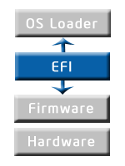
Why PXE and EFI?
Why PXE?
Fast way to image and re-image servers
Well known; well documented
Can be used for variety of OS versions.
Minimal infrastructure requirement, all open source.
Why EFI?
Faster boot
Default boot method on newer servers
Support for GPT partitioning (larger disks)
MS heavily promoting “secure EFI boot”

Slide 3
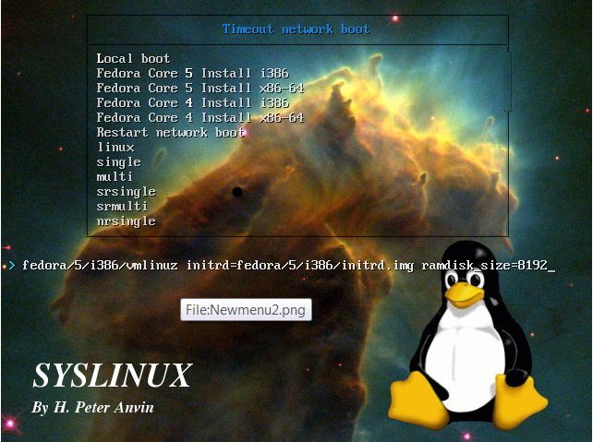
Why PxeLinux?
Professional-looking menus!

Slide 4
Organization of this Presentation
Simplest setup first (legacy PXE client only)
Add complexity; regular DHCP clients + legacy PXE clients
Add complexity; regular DHCP clients + EFI PXE clients + legacy PXE clients

Slide 5
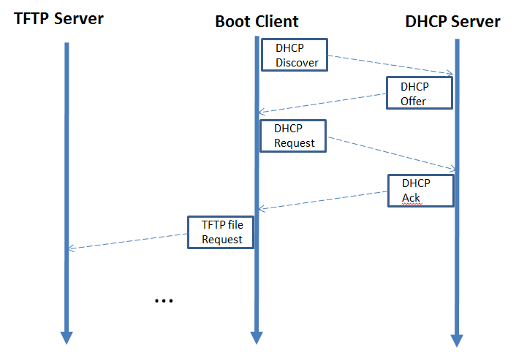
What is PXE?
PXE consists of two phases:
Initial DHCP session, with a “enhanced DHCP” packet sent
An ensuing file transfer phase (typically TFTP), where the NBP (Network Bootstrap Program) is loaded
After initial NBP loaded, it knows enough to load the rest of the necessary modules to image the OS.

Slide 6

What do I need?
DHCP server
ISC DHCP server (available with Ubuntu & RHEL) works nicely.
If not ISC, then a DHCP server that understands ISC syntax.
TFTP server
Atftpd or tftpd-hpa (both available with Ubuntu & RHEL)
Web server (or NFS server). to transfer over content.
In this presentation, I use a standard Apache server.
Syslinux
If doing legacy (BIOS) PXE only, any version > 4.0 will work.
If doing EFI PXE, need version 6.03-pre6 or higher.

Slide 7
Setup
Internet
Legacy PXE
Client
DHCP
Client
EFI PXE
Client
192.168.1.xx
192.168.0.xx
eth1
eth0
192.168.0.100
PXE Server
(DHCP, TFTP,
Apache)

Slide 8
DHCP Server -- PXE clients only
/etc/default/isc-dhcp-server
# On what interfaces should the DHCP server (dhcpd) serve DHCP requests?
# Separate multiple interfaces with spaces, e.g. "eth0 eth1".
INTERFACES="eth1"
/etc/dhcp/isc-dhcp-server
authoritative;
subnet 192.168.1.0 netmask 255.255.255.0 {
}
subnet 192.168.0.0 netmask 255.255.255.0 {
range 192.168.0.10 192.168.0.49;
default-lease-time 120;
max-lease-time 120;
option routers 192.168.0.100;
option ip-forwarding off;
option broadcast-address 192.168.0.255;
option subnet-mask 255.255.255.0;
option ntp-servers 192.168.0.100;
option domain-name-servers 192.168.1.254;
next-server 192.168.0.100;
filename "pxelinux.0";
}

Slide 9

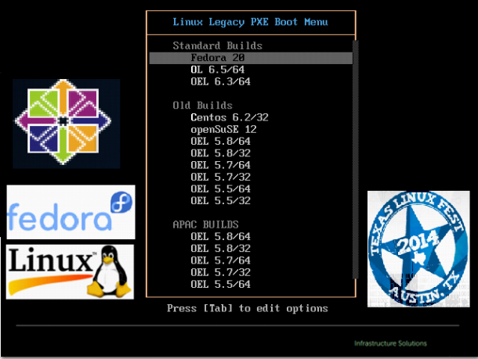
TFTP directory layout
/var/lib/tftpboot/
├── boot/
│ ├── centos/
│ │ └── 6.2/
│ │ └── x86_64/
│ │ ├── initrd.img
│ │ └── vmlinuz
│ └── fedora/
│ ├── initrd.img
│ └── vmlinuz
├── SplashP.png
├── graphics.conf
├── ldlinux.c32
├── libcom32.c32
├── libutil.c32
├── pxelinux.0
├── pxelinux.cfg/
│ └── default
└── vesamenu.c32
Notes:
All pxelinux binaries and libraries at top-level. Pxelinux configuration files under pxelinux.cfg/. All OS boot kernels under boot/

Slide 10
Constructing this TFTP structure
# cd /tmp
# wget https://www.kernel.org/pub/linux/utils/boot/syslinux/syslinux-6.03.tar.gz
# tar xzvf syslinux-6.0.3.tar.gz
# cd syslinux-6.03/bios/
# cp core/pxelinux.0 com32/elflink/ldlinux/ldlinux.c32 \
com32/menu/vesamenu.c32 com32/lib/libcom32.c32 \
com32/libutil/libutil.c32 /var/lib/tftpboot
# cd /var/www/fedora
# ls -lh Fedora-20-x86_64-DVD.iso
-rw-r--r-- 1 spike spike 4.3G Mar 16 20:53 Fedora-20-x86_64-DVD.iso
# mkdir 20_full/
# mount –o loop Fedora-20-x86_64-DVD.iso 20_full/images/pxeboot
# FEDORA=/var/lib/tftpboot/boot/fedora
# mkdir –p $FEDORA
# cp vmlinuz initrd.img $FEDORA
# cd /var/lib/tftpboot
# mkdir pxelinux.cfg
…Now construct a pxelinux.cfg/default file….

Slide 11
Pxelinux.cfg/default file
UI vesamenu.c32
PROMPT 0
MENU TITLE Linux Legacy PXE Boot Menu
MENU RESOLUTION 640 480
MENU BACKGROUND SplashP.png
MENU INCLUDE graphics.conf
LABEL -
MENU LABEL Standard Builds
MENU DISABLE
LABEL Fedora 20
MENU LABEL ^fedora 20
MENU INDENT 3
KERNEL boot/fedora/vmlinuz
APPEND initrd=/boot/fedora/initrd.img ramdisk_size=10000 ks=http://192.168.0.100/fedora/fedora_generic.cfg

Slide 12
Simple ks.cfg file
# cd /var/www/fedora
# cat fedora_generic.cfg
install
url --url http://192.168.0.100/fedora/20_full
lang en_US.UTF-8
keyboard us
network --bootproto dhcp
rootpw --iscrypted $1$o/HqbZSt$gq16hrOxZOYYKNPVzoFyG.
firewall --disabled
authconfig --enableshadow --enablemd5
selinux --disabled
timezone --utc America/Chicago
reboot

Slide 13
Final Result – Time for Demo!
Notes:
Fix.

Slide 14
Legacy PXE clients + DHCP clients
/etc/dhcp/dhcpd.conf changes:
...
class "pxe-clients" {
match if substring (option vendor-class-identifier, 0, 9) = "PXEClient";
set vendor-string = substring ( option vendor-class-identifier, 0, 9);
option bootfile-name "pxelinux.0";
option tftp-server-name "192.168.0.100";
next-server 192.168.0.100;
}
subnet 192.168.1.0 netmask 255.255.255.0 {
}
subnet 192.168.0.0 netmask 255.255.255.0 {
range 192.168.0.50 192.168.0.99;
...
pool {
allow members of "pxe-clients";
range 192.168.0.10 192.168.0.49;
}
}
Notes:
Introduces a DHCP class and associated address range pool.
If std DHCP client, will get address in rang 192.168.0.50 -99.
If PXE client, will get address in range 192.168.0.10 – 49.

Slide 15
EFI boot
When client does EFI boot, a special EFI bootloader must be used
efi32/syslinux.efi for a 32-bit EFI client
efi64/syslinux.efi for a 64-bit EFI client
bios/core/pxelinux.0 for legacy PXE client
All above bootloaders supplied with syslinux package
Once EFI bootloader loaded, it loads the same kernel and initramfs as before.

Slide 16
Legacy PXE, DHCP & EFI PXE clients
1. Match on VCI
class "pxe-clients" {
match if substring (option vendor-class-identifier, 0, 9) = "PXEClient";
set vendor-string = substring ( option vendor-class-identifier, 0, 9);
set vendor-class option vendor-class-identifier;
option tftp-server-name "192.168.0.100";
next-server 192.168.0.100;
if option vendor-class-identifier = "PXEClient:Arch:00000:UNDI:002001" {
option bootfile-name "bios/pxelinux.0";
} elsif option vendor-class-identifier = "PXEClient:Arch:0007:UNDI:003016" {
option bootfile-name "efi.x64/syslinux.efi";
} else {
option bootfile-name "UNKNOWN_VCI";
}
}

Slide 17
Legacy PXE, DHCP & EFI PXE clients
2. Match on arch.
…
# In initial DHCP DISCOVER packet, PXE client sets option 93 to its arch.
# 0000 == IA x86 PC (BIOS boot)
# 0006 == x86 EFI boot
# 0007 == x64 EFI boot
option arch code 93 = unsigned integer 16;
class "pxe-clients" {
match if substring (option vendor-class-identifier, 0, 9) = "PXEClient";
...
if option arch = 00:00 {
filename "bios/pxelinux.0";
} elsif option arch = 00:07 {
filename "efi.x64/syslinux.efi";
} else {
filename "UNKNOWN_VCI";
option bootfile-name "UNKNOWN_VCI";
}
}

Slide 18
Legacy PXE, DHCP & EFI PXE clients
3. Subclasses
class "pxe-clients" {
match option vendor-class-identifier;
…
option tftp-server-name "192.168.0.100";
…
next-server 192.168.0.100;
}
subclass "pxe-clients" "PXEClient:Arch:00000:UNDI:002001" {
option bootfile-name "bios/pxelinux.0";
}
subclass "pxe-clients" "PXEClient:Arch:0007:UNDI:003016" {
option bootfile-name "efi.x86/syslinux.efi";
}

Slide 19
New TFTP dir structure
.
├── bios
│ └── … same as previous top-level …
└── efi.x64
└── boot -> ../bios/boot
├── SplashP.png -> ../bios/SplashP.png
├── graphics.conf -> ../bios/graphics.conf
├── ldlinux.e64
├── libcom32.c32
├── libutil.c32
├── pxelinux.cfg
│ └── default
├── syslinux.efi
└── vesamenu.c32
Notes:
Efi.x64 can be a symlink to bios/boot, same vmlinuz/initrd.img files.

Slide 20
Constructing new EFI TFTP structure
# cd /var/lib/tftpboot
# mkdir bios/
# mv * bios/
# mkdir efi.x64; EFI64=`pwd`/efi.x64
# cd /tmp/syslinux-6.03/efi/
# cp efi/syslinux.efi com32/elflink/ldlinux/ldlinux.e64 \
com32/menu/vesamenu.c32 com32/lib/libcom32.c32 \
com32/libutil/libutil.c32 $EFI64
# cd $EFI64
# ln –s ../bios/boot .
# mkdir pxelinux.cfg
…Now construct a pxelinux.cfg/default file….

Slide 21
efi.x64/pxelinux.cfg/default file
UI vesamenu.c32
PROMPT 0
menu title Linux EFI PXE Boot Menu
MENU RESOLUTION 640 480
MENU BACKGROUND DellSplashP.png
MENU INCLUDE graphics.conf
LABEL -
MENU label Standard Builds
MENU DISABLE
LABEL Fedora 20
MENU LABEL ^fedora 20
MENU INDENT 3
MENU DEFAULT
KERNEL boot/fedora/vmlinuz
APPEND initrd=/boot/fedora/initrd.img ramdisk_size=10000 ks=http://192.168.0.100/fedora/fedora_efi_generic.cfg

Slide 22
Other configuration changes
ks.cfg file
bootloader --location=partition --driveorder=sda
zerombr
if setting up partitioning in ks.cfg, prepend:
part /boot/efi --fstype vfat --size=300 --asprimary
vmlinuz, initrd.img – no change.
Notes:
--location=partition required for EFI boot.
Zerombr is to whack the boot image we just laid down with our legacy PXE boot.
EFI booting requires extra partition /boot/efi of type vfat.

Slide 23
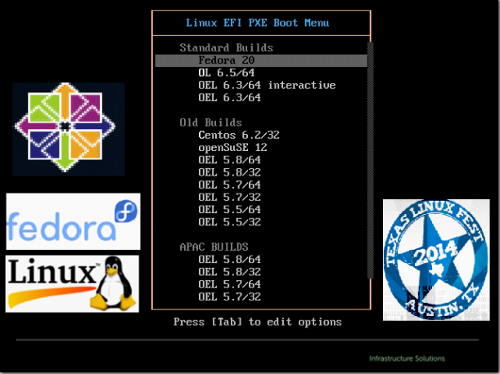
Final Result – Time for Demo!
Notes:
Fix.

Slide 24
Troubleshooting
Look at your logs!
DHCP server logs
TFTP server logs
Apache access logs
Wireshark is your friend! (particularly in DHCP/TFTP phases)
Get simple case working first.
Get PXE client-only working first.
Then handle multiple arch’s in dhcpd.conf
Finally get EFI working.
Syslinux mailing list is great.

Slide 25
Conclusion
With just a few open-source packages and one Linux server, you can construct your own PXE server
Supporting only legacy PXE clients is very easy.
Supporting both DHCP clients and PXE clients is relatively easy.
Adding EFI PXE clients adds complexity to configuration, but is achievable.

